Slide 1



Exploratory Data Analysis (EDA)
Dr. Nawana Coyle School of Technology, National University TIM-8501: Exploratory Data Analysis February 19, 2023

Slide 2
Content
Introduction:
What is EDA
Purposes of EDA
Where EDA fit in
Methods
Summary
Tools
Notes:
Exploratory data analysis (EDA) is an essential step in the data science project development. It helps explore the given data, find patterns within the dataset’s variables, evaluate hypotheses, find correlations between variables, and get the data ready for the data modeling step in a project. Therefore, it is crucial to understand what EDA is and the benefits it introduces to a data science project. In this presentation, the processes in EDA will be dissected to understand the purposes of EDA, where it fits in the project development process, the tools it uses to accomplish the goals and different EDA methods.

Slide 3
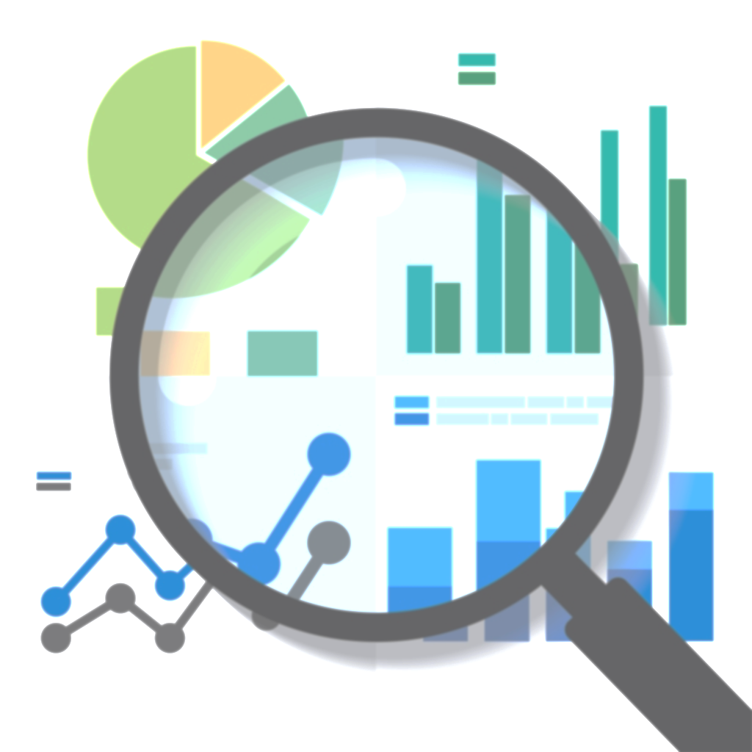
What is EDA
- An analytical process
Helps find patterns
Identify abnormalities and inconsistencies
Present findings in easy-to-understand visualizations
Curate data for predictive modeling
3
This Photo by Unknown Author is licensed under CC BY-NC
Notes:
The first step in a data science project is identifying a problem that needs to be answered. Then an appropriate dataset from a reputable source is chosen, and it goes through the curation process, which addresses the missing data, the data inconsistencies, and any format changes that need to be done. Data then enters the exploratory analysis phase which helps the researchers find patterns within the dataset. This could involve one or multiple variables at a given time, and EDA uses graphical and non-graphical methods to communicate the information and any inconsistencies within the dataset. And finally, data could go through another curation process prior to entering the modeling phase of the data science project development process. In the next slide, let’s take a closer look at the EDA process.

Slide 4
Where does EDA fit in ?
Business objective
Data Collection
Data Cleaning
Exploratory Data Analysis
Monitoring
Deployment
Evaluation
Modeling
4
Notes:
A data science project aims to extract insights from data that can be used to answer certain hypotheses. Therefore, at the beginning of a project development, the research identifies a research problem that needs to be further investigated. And a research question surrounding problem is generated, and hypothesis/predictions are made. These hypotheses need testing to get clarity for the topic. Therefore, the next step in a data science project is to collect the data from a reputable source and pass it through a data cleaning process. This helps address the issues related the missing values, data duplicates and inconsistent data types. Once The missing values are either eliminated from the dataset or replaced with measures such as the mean or the mode, and duplicates are removed, the variables need to be changed to appropriate data types. For example, a date may have been entered as an object instead of a date. Once properly cleaned, the data is passed on to the exploratory data analysis phase.
EDA helps gain insights from the data concerning how variables relate to the target and how variables correlate. Once these connections are identified, and further data processing is performed, data enters the modeling phase. The dataset is divided into training, validation and testing datasets, and the training dataset is fitted to a few models. Appropriate measures are used to evaluate the model’s performance. For example, evaluation metrics such as accuracy and recall are used in a classification problem such as the heart disease detection project. The parameters of the models are turned to get better evaluation metrics. Once optimal results are achieved, the project is deployed for monitoring throughout to ensure that the newly entered data generates similar evaluation results.

Slide 5





Purposes of EDA
Detect anomalies &
identify important variables
Understand data correlations
Check Assumptions/
Test Hypothesis
Create data-driven-insights
Further process data for modeling
5
Notes:
There are a few purposes associated with EDA. First and foremost, before a dataset enters the modeling stage in the project development, it is essential to identify the variables in a dataset that impact the target. For instance, a healthcare dataset could consist of thousands of rows, and hundreds of columns. And each column which is a dataset variable, might not be a determining factor of the prediction. For example, assuming we’re working with a heart disease prediction project, the project aims to identify patients most vulnerable to developing heart disease. So in this classification problem, the chosen dataset may have a patient’s first name, last name, address, etc., with clinical data such as the blood pressure levels, preexisting conditions etc. While blood pressure levels and preexisting conditions may be essential factors in the classification problem, patient names and addresses are not. Therefore, EDA helps identify critical variables that impact the project target. Features such as heatmaps and pairplots are great tools which help identify important variables in a dataset.
Anomalies are data irregularities in a dataset and could be caused by data corruption or human error. Identifying the data anomalies can help reduce operational and business risks for an organization, identify malpractices and potential threats, and minimize inaccurate insights and conclusions derived from the dataset. EDA can help detect anomalies in a dataset by calculating the central tendency measures, such as the mean, median and mode, and the variance measures, such as the outliers and range. A dataset with extremely high or low values in a certain variable would impact the mean for that specific variable. Since these extreme values are not typical, calculating the mean, the median and the outliers, the researchers can use EDA to quickly identify variables with anomalies and exclude those extreme values in the data analysis and modeling process.

Slide 6
Purposes of EDA Continued…
Detect anomalies &
identify important variables
Understand data correlations
Check Assumptions/
Test Hypothesis
Create data-driven-insights
Further process data for modeling
6
Notes:
Understanding correlations helps identify variables which need further investigations and can be included in the hypothesis testing to understand how these features affect one another. Tools such as heatmaps help identify the strength of relationship between the variables. For instance, the correlation efficiency ranges from -1 to 1, and a correlation nearing -1 indicates strong negative correlation where when the value of one variable increases, the other decreases. Similarly, a correlation coefficient reaching 1 suggests strong positive correlation where both variables move in the same direction. And value nearing 0 indicates that there is no correlation between the variables. Pairplots also are a great tool which helps understand correlation between different variables. They help see distributions of single variables and the relationships between 2 variables.
Producing a prediction and testing that prediction to find if the prediction is accurate or not is the fundamentals of hypothesis testing. Whether a data science project is a classification or a regression problem, hypothesis testing helps create predictions from the dataset and gain insights from it. For example, in a heart disease project, where the data is used to identify patients most vulnerable to developing heart disease, one of the assumptions that can be made is that high blood pressure contributes to heart disease. This assumption can be tested by creating a bar chart with the value counts of people with high and no blood pressure. Similarly, assuming there is no difference in heart disease development between men and women, the value counts of the males and females can be put into a bar plot to see if there is any difference in the sexes of the patients.

Slide 7
Purposes of EDA Continued…
Detect anomalies &
identify important variables
Understand data correlations
Check Assumptions/
Test Hypothesis
Create data-driven-insights
Further process data for modeling
7
Notes:
The EDA process involves creating graphical presentations to show the data driven insights. In the example of the heart disease detection project, scatter plots can be used to understand the relationship between high blood pressure values and the blood sugar values in patients and separate them by heart disease diagnosis where patients which heart disease will be shown in dots with one color and patients without heart diseases will be shown in another. This will give the researchers a good understanding as to how each variable contributes to the disease development.
Even though the data goes through the curation process before the exploratory data analysis phase, certain times, data may need to be further processed to be ready for modeling. For example, if a certain variable contains categorical data and it is assumed to be contributing in the decision making process, it may need to be converted to a numerical data format for further analysis. For example, suppose the researcher assumes that type of a sex of the patient contributes to the development of heart disease. In that case, this categorical variable may need to be converted to a numerical value, such as 1 for men and 0 for women, so it can be successfully fitted into a model. This further data processing in EDA makes the predictions more accurate and relevant in a project.

Slide 8
Variable Data Types
Ordinal
Structured Data - CVS files
- Excel - Database
Categorical
Nominal
Discrete
Unstructured Data - Images - Videos - Audios
Numerical
Continuous
Notes:
Variables can be categorized into structured or unstructured data. Structured data in data files such as excel, and csv files have variables labeled and are generally organized and formatted. Unstructured data, such as images and audio files, on the other hand have no labels and has no predefined format or organization, making it difficult to analyze compared to structured data.
Structured data are further divided into categorical and numerical data. Categorical data are variables containing categories of data, which could be ordinal or nominal. Ordinal data has a predetermined order, whereas nominal data has no order. For example, satisfaction rating is an ordinal data type ranked from extremely satisfied to highly dissatisfied. Nominal data categories, such as sex which consist of males and females, have no order.
Numerical data can be of discrete data type or continuous data type. Discrete data variables can be presented with a whole number, and continuous data uses float data type. Number of previous heart attacks is a discrete data value, and height is a continuous value that includes decimals.

Slide 9
. Languages R Python Packages - Pandas - NumPy - Matplotlib - Seaborn
Tools Used in EDA
9
Notes:
R and python are the most frequently used languages in exploratory data analysis (EDA). They both have built-in packages which help in the EDA process. Python, for example, has four main packages that are used in EDA. They are pandas, NumPy, Matplotlib and Seaborn. Pandas help load the datasets, clean them, analyze them , and manipulate data such as dropping columns, renaming them, or slicing them.
NumPy helps conduct mathematical operations in a dataset, from addition to multiplication to creating arrays. This can be beneficial when working with multiple columns or transforming column units. For example, if patients’ temperatures are recorded in Celsius and need to be transformed into Fahrenheit, NumPy can help immensely.
Matplotlib and Seaborn are python libraries which support visualizations. While they both create bar plots, scatter plots and box plots, seaborn provides much ease and less code to create visualizations. Therefore, combining all these tools is incredibly beneficial in the EDA process.

Slide 10
. Heatmaps . Plots - Bar plots - Histogram - Scatter plots - Box plots - Line plots - Violin plots - Pair plots - Pie charts
Tools Used in EDA
10
Notes:
Heatmaps and plots are the most beneficial for researchers among the many tools used in EDA. They not only help visualize insights obtained from the dataset, but also help create predictions that could lead to future research opportunities. Heatmaps use color to represent the correlation between two variables. And high correlation coefficient values nearly one, low values nearing -1 show high correlations between the variables, and the values nearing 0 show no correlation at all.
Different plots are used in the EDA process depending on the number of variables considered and the type of value. Bar plots for example, can be beneficial in understanding the value counts of categorical variables. Histograms, on the other hand, help show the distribution of a numeric dataset. Scatter plots show the correlation between two or more variables. Box plots help understand the outliers of a dataset which help understand how majority of the data in a dataset behave. Pair plots help identify the most separate clusters or clear correlation between two variables. And pie chart helps identify the percentage each category in a dataset contributes to the whole. For example, data in the sex column in the heart disease data set can be presented in a pie chart where percentages of men and women will be presented in two slices in the circle, with both adding up to 100%.

Slide 11
EDA Methods
Univariate
Non-graphical
Univariate
graphical
Multivariate
Non-graphical
Multivariate
graphical
11
Notes:
Exploratory data analysis is divided into four different types. They are univariate non-graphical EDA, univariate graphical EDA, multivariate non-graphical EDA and multivariate graphical EDA. In the next slide, these four types will be further discussed.

Slide 12

EDA Comparison
Univariate
Non-graphical EDA
Univariate
Graphical EDA
Central tendency
Mean
Median
mode
Spread
Variance
Range
Outliers
Skewness & kurtosis
Histogram
Boxplot
Line plot
Pie chart
12
Notes:
Univariate EDA considers only one variable at a time. And univariate non-graphical EDA is the simplest form of data analysis which uses statistical measures to understand the dataset better. It uses central tendency measures such as the mean, median and model to evaluate the dataset. For example, if the mean, median and more are the same for a given data distribution, it is said to be normal. However, if the mean is calculated to be higher than the median, that is caused by the extremely high value outliers and are said to have a positive skew with a tail towards the positive side of the x-axis. On the contrary, a dataset with a mean less than the median is said to be caused due to the negative outliers and takes a left tail with values spreading further on the negative side of the x-axis.
Similarly, spread measures such as the variance and the standard deviation are an excellent univariate non-graphical EDA method. They help understand how spread out the data is compared to the mean in a dataset. Skewness focuses on the side where the tail is facing on a distribution. In contrast, kurtosis helps understand the thickness of the curve, which indicates how many values are in the tails of a distribution which gives a better understanding to the number of outliers in the dataset.
Univariate graphical EDA focuses on one variable at a time and uses visual aid to evaluate the dataset. Histograms for example, takes one variable at a time helps plot its distribution. A great example of univariate graphical EDA would be the histogram to show the distribution of blood pressure levels of heart patients. Similarly, pie charts, line plots and box plots can be used to understand the representation of a single variable at a time.

Slide 13
EDA Comparison
Multivariate
Non-graphical EDA
Multivariate
Graphical EDA
Correlation coeffient
Covariance
Cross-tabulation
Range & spread
Scatter plots
Pair plots
Heatmaps
Side-by-side boxplots
Group by bar plots
13
Notes:
Multivariate EDA analyzes two or more variables at a time. Multivariate non-graphical EDA uses measures such as correlation coefficient, covariance, mean, median and variance to understand the datasets. Correlation coefficient helps understand the direction and the strength of the relationship between the predictor and the response variables. For example, the correlation coefficient of the heart disease projects can be measured for the variables in the dataset against the disease development. The variables with high positive values indicated that those variables had a strong positive correlation to the disease development. Similarly, features with low values nearing 0 indicated that the feature had a little to no impact on developing heart disease.
Covariance is the directional relationship between two variables. And it is a mathematical function found in the NumPy library. A high positive covariance value shows robust and positive relationship, which indicates that when values in one variable increases, the values in the other variable increases too.
Cross tabulation is another multivariate non-graphical EDA method that can evaluate two variables. In the example of the heart disease project, gender can be cross tabulated against diabetes diagnosis. Therefore, four categories of patients will be created from the two chosen variables. They are diabetic positive men, diabetic positive women, diabetic negative men, diabetic negative women. Using similar techniques on different features, calculating their percentages helps draw more precise insights from a large dataset.
Multivariate graphical EDA uses visualizations to evaluate two or more variables in a dataset. Scatter plots, for example, can take two or more features to show their correlation. For example, the blood pressure values can be plotted against blood sugar levels using a scatter plot. The dots can be further analyzed by gender by assigning the gender to a specific color. Similarly, side-by-side bar plots help analyze the means, the low and high limits and outliers of data distributions. For example, these can be used to visualize the number of impatient and outpatients visits of patients against their ages.

Slide 14
Summary
- Exploratory data analysis (EDA) is essential to data science project development.
It helps gain insights into the dataset, uncover patterns, find correlations and anomalies, and test hypotheses.
There are 4 main EDA methods. Depending on the number of variables evaluated, the appropriate EDA method can be used to better understand the dataset.
14
Notes:
Exploratory data analysis (EDA) is an essential step in the data science project development. It helps gain insights from the data concerning how variables relate to the target and how variables correlate. It helps identify the variables in a dataset that impact the target. EDA also help detect anomalies in a dataset by calculating the central tendency measures, such as the mean, median and mode, and the variance measures, such as the outliers and range. EDA tools such as heatmaps help identify the relationship strength between the variables. Whether a data science project is a classification or a regression problem, hypothesis testing helps create predictions from the dataset and gain insights from it. The EDA process involves creating graphical presentations to show the data driven insights. Even though the data goes through the curation process before the exploratory data analysis phase, certain times, data gets further processed during EDA to get the data ready for modeling.
There are four EDA methods: univariate non-graphical EDA, univariate graphical EDA, multivariate non-graphical EDA and multivariate graphical EDA. univariate non-graphical EDA is the simplest form of data analysis which uses statistical measures to analyze one variable at a time.
In contrast, univariate graphical EDA focuses on one variable at a time and uses visual aid to evaluate the dataset. Multivariate non-graphical EDA uses measures such as correlation coefficient, covariance, mean, median and variance to understand two or more variables in a dataset. Multivariate graphical EDA uses visualizations to evaluate two or more variables in a dataset.

Slide 15
References
Blau, F. D. & Kahn, L. M. (2017). The Gender Wage Gap: Extent, Trends, and Explanations. Journal of Economic Literature, 55 (3): 789-865.DOI: 10.1257/jel.20160995. https://www.aeaweb.org/articles?id=10.1257%2Fjel.20160995&source=post_page
Katch RK, Scarneo SE, Adams WM, Armstrong LE, Belval LN, Stamm JM, Casa DJ. Top 10 Research Questions Related to Preventing Sudden Death in Sport and Physical Activity. Res Q Exerc Sport. 2017 Sep;88(3):251-268. doi: 10.1080/02701367.2017.1342201. PMID: 28805553.
Mukhiya, S. K. & Ahmed, U. (2020). Hands-On Exploratory Data Analysis with Python. Packt Publishing. (Original work published 2020).
Patil, P. (2018). What is Exploratory Data Analysis? https://towardsdatascience.com/exploratory-data-analysis-8fc1cb20fd15

Slide 16

Thank you

